Slide 1
The Librarian’s Dilemma
Team #01
Bingran Hu, Zhihao Lin
Yi Jia Zhang, Zetong Zhao

Slide 2
Objectives
Optimize the number of steps and commands needed for re-arranging the books in the Library of Babel
Objective 1 (Part 1)
write parser function to read input
Implement generator function to produce output
Objective 2 (Part 2)
optimize the number of steps to get the desired result (may not be unique)
Objective 3 (Part 3)
optimize the number of commands (may not be unique)

Slide 3
Our General Approach
Implement a parser to transform the given data into two vectors
std::vector<string>
original, desired
Use dynamic programming to find minimum steps needed to change original into desired
2D dynamic programming vectors
Optimize the number of steps, not commands
Backtrack the DP array to analyze the number of commands needed
Search for all the leaf nodes that would produce the optimal solution in Part2
Calculate the number of commands for each leaf node
Use various optimization techniques to shorten the search time
Compile and print out the commands in sequence

Slide 4
Parser
Declared two vectors that contain two lists of books
original - Original arrangement
desired - Desired arrangement
Read the data from the input data file using <fstream>
These two vectors will be used for dynamic programming in the next part
Another parser is created to pass the test cases for part 2
The file is passed in as a vector of characters.

Slide 5
Dynamic Programming
Using a two dimensional array (vector) as a dynamic programming matrix:
Row: the desired sequence (characters in part 2, or strings in part 3)
Col: the original sequence
D[i][j] represents the minimum steps required to edit the first i elements in the original sequence to be identical with the first j elements in the desired sequence.
i = 0 or j = 0 indicates that original[] or desired[] is empty, where D[0][j] = j and D[i][0] = i.

Slide 6
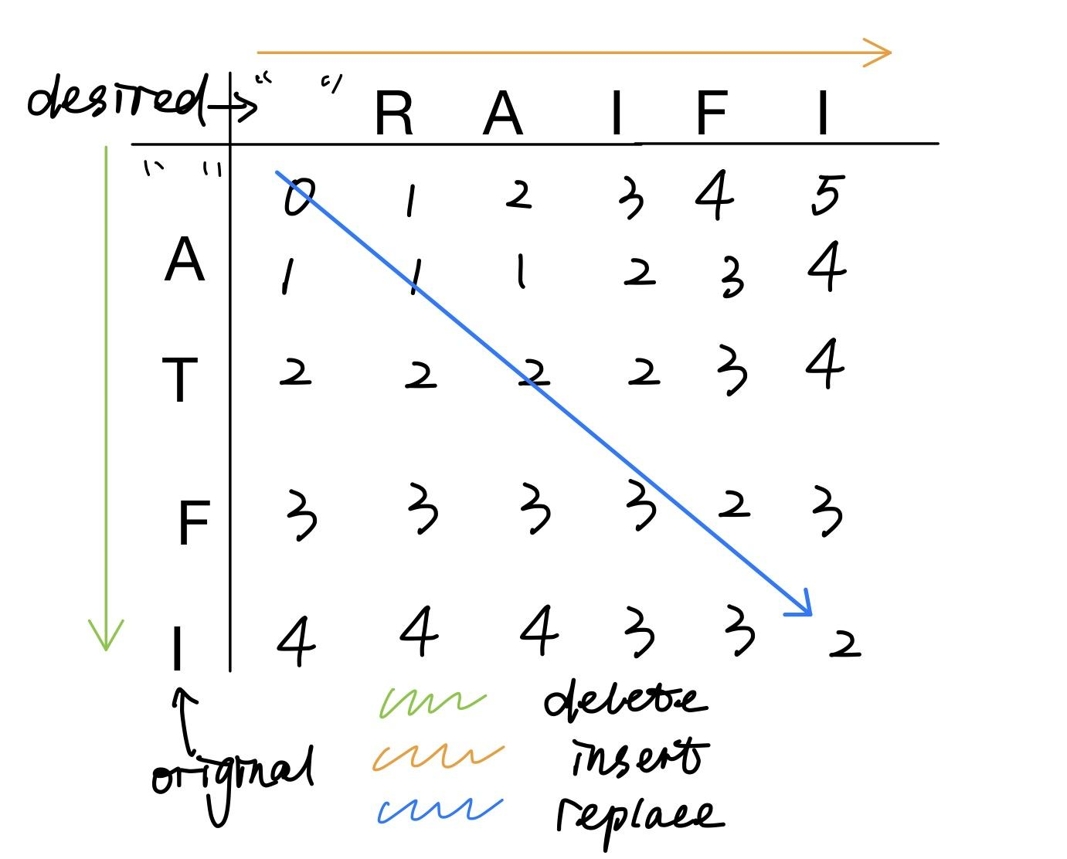
Dynamic Programming
When the original[i] and desired [j] are identical:
D[i][j] = D[i-1][j-1] (no operation required)
Otherwise:
D[i][j] = 1 + min(D[i-1][j], D[i][j-1], D[i-1][j-1] - 1)
D[i-1][j]: delete original[i - 1]
D[i][j-1]: insert desired[j - 1] after original[i - 1]
D[i - 1][j - 1]: replace original[i - 1] by desired[j - 1]

Slide 7
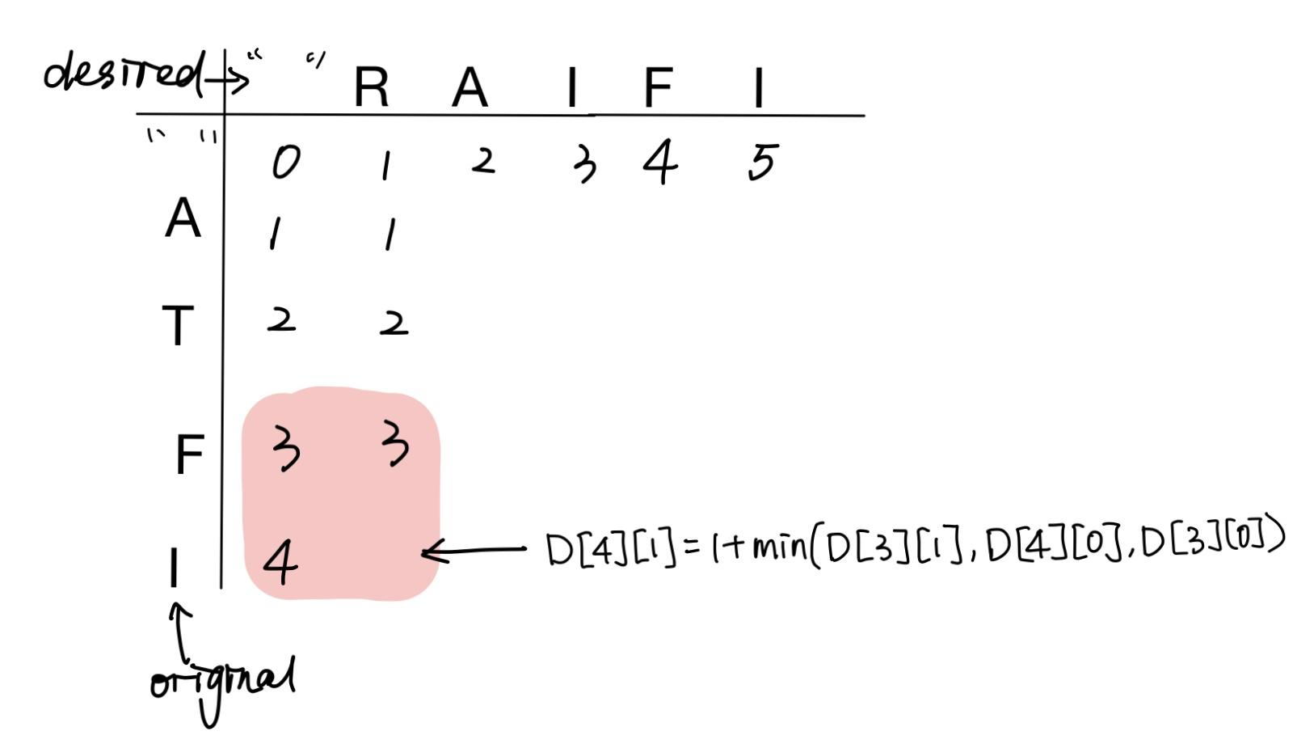
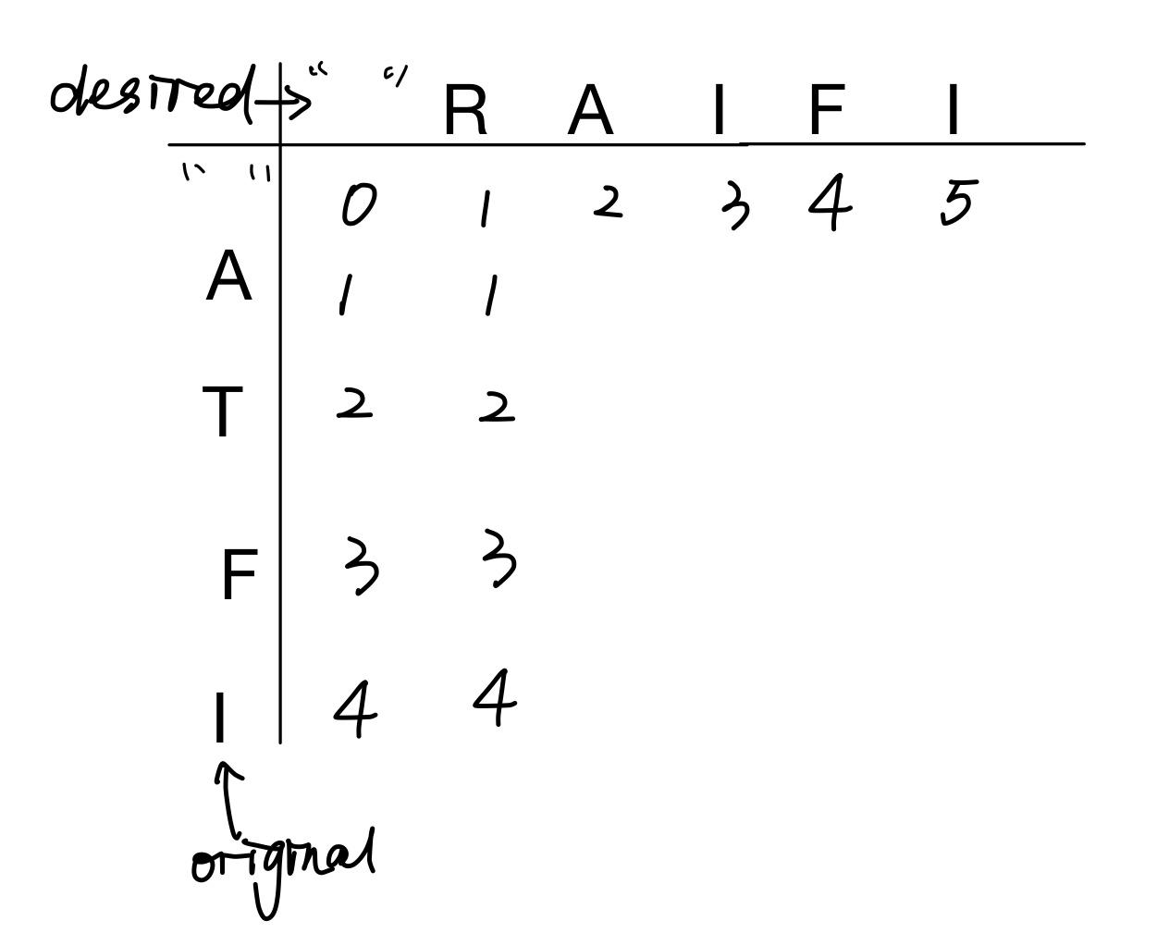
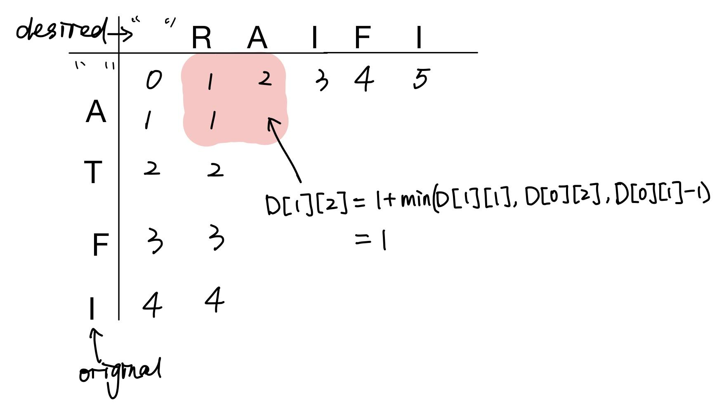
Dynamic Programming

Slide 8
Part3-Minimize commands
Analysis different possible list of commands acquired
When the successive operations are identical and the position indice are continuous then these operations can be combined into one command
When an insertion is followed by a deletion, then these operations can be combined into a replacement
By doing so, we can find the minimum number of commands with the least number of steps for re-arranging the books in the library, therefore, we have completed objective Part 3.

Slide 9
We had a great idea!
Use branch-cut to shorten the DFS search
When the number of commands for one path is found, assume it is N, we don’t need to search for other branches that are guaranteed to produce a result that is larger than N.
We record the current number of commands used, and if it exceeds the number N, we return back to its parent node rather than searching deeper into the tree.
As a result, we won’t need to search all the paths, calculate their respective number of commands, and find the minimum among them. This optimization technique speeds up the convergence of the optimal solution.

Slide 10
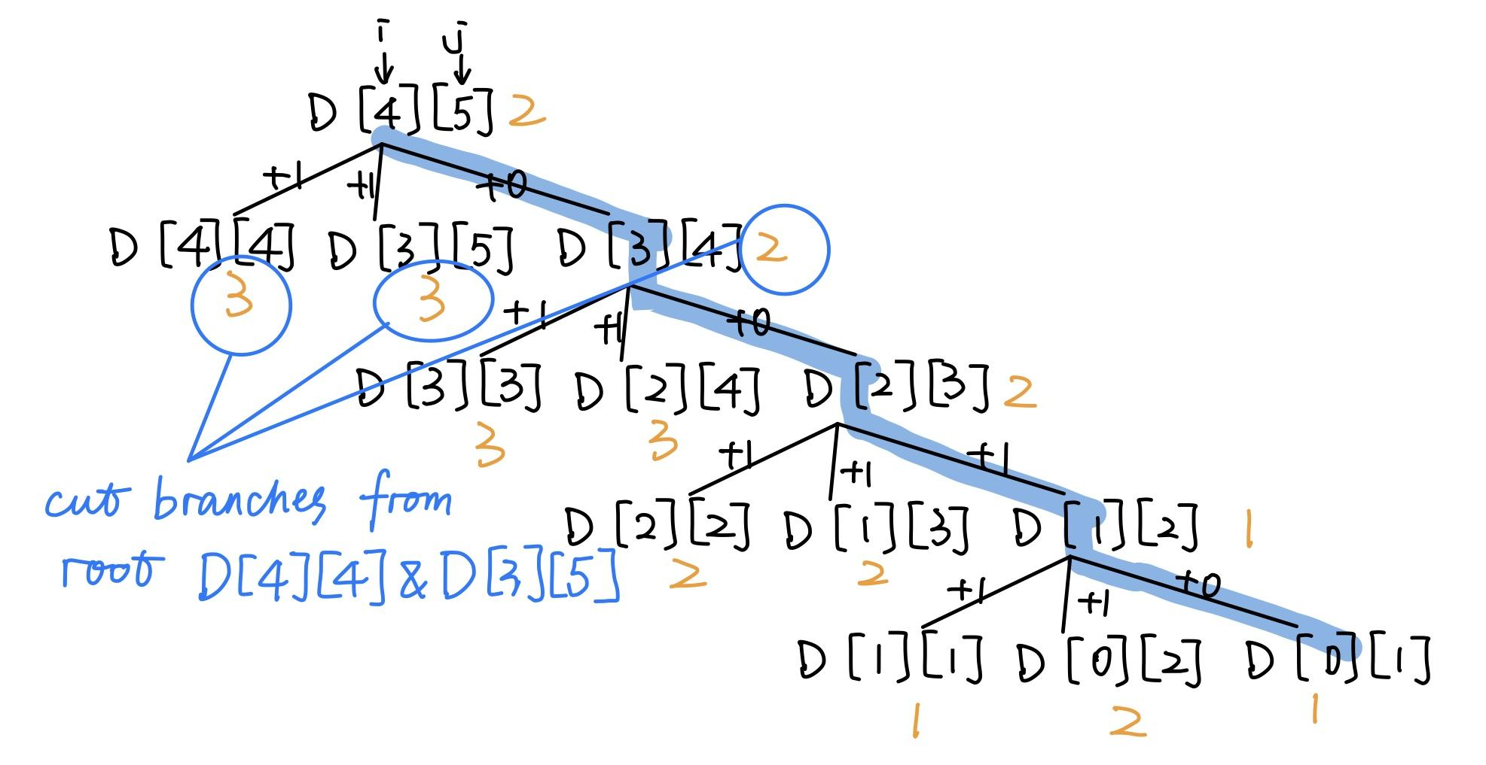

Slide 11
HOWEVER!
It didn’t work
DFS did not converge

Slide 12
Alternative approach (Heuristic)
Create a new 2D array that has the same dimensions as the DP array
Instead of waiting until the leaf node is reached, compare the number of the commands along the tree path.
If the number of commands at the current position [i][j] greatly exceeds the minimum number of commands used (from other paths) that is previously stored at this position, it is highly likely that the final result will not be optimal either.
It is tested that with this optimization technique, the DFS search can converge.
Very Fast for test case 31, 32
Takes 2-3 seconds for test case 33, 34

Slide 13
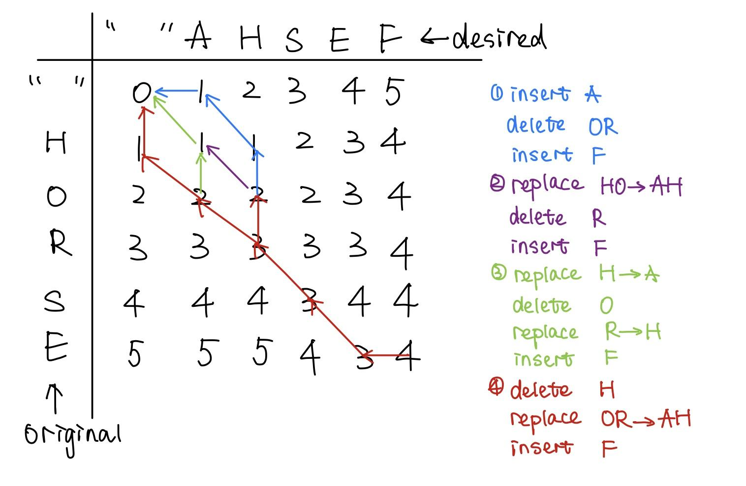
Example(with different number of commands)

Slide 14
Next Steps
By treating the dynamic programming matrix as a map, the problem can be solved through finding the minimum path.
Each combined command can be seen as a single path since it links a straight line between two nodes. (vertical, horizontal, or diagonal)
This solution may be more effective in terms of run time.

Slide 15
Thank You

